Slide 1
SOD feature study for trailer connection scenario.

Slide 2

Two ways of trailer connection handling
Not working/disabled
Auto disable BLIS and CTA (Trailer tow module(s) less BTT)
Auto extend BLIS detection zone to cover trailer blind zone(BLIS with Trailer Tow, A.K.A BTT)
*
Partially working
BLIS
After trailer connection
CTA
Trailer
BLIS
*
BLIS
BTT
After trailer connection
CTA
Trailer
BLIS
BTT
*

Slide 3
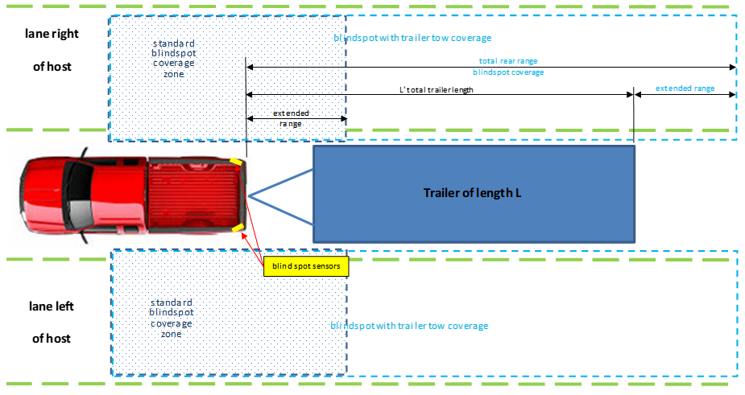
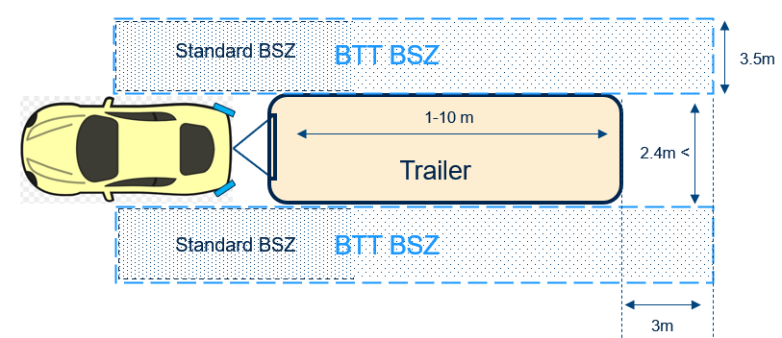
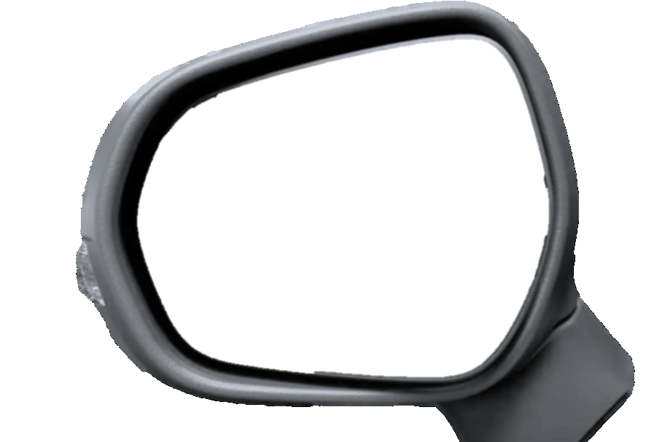

BTT light Feature Overview
BTT or BTT light?
BTT: BLIS with Trailer Tow
BSZ: Blind Spot Zone
Definition: BLIS is a convenience feature that aids the driver in assessing whether a vehicle is in or will be entering an area, called BSZ, BTT will extend the standard BSZ per the trailer length, acting the same as BLIS but with an extended BSZ, if trailer is connected.
Target Users:
Host car driver who needs to know the status of BZ.
Implementation summary:
BSZ definition and trailer requirement for BTT light
Target detection: Two Rear corner radars to detect incoming threat from rear on each side
Warning driver with Visual Warning (Side Mirror LED ON)
Standard BSZ
BTT BSZ
Trailer
Standard BSZ
BTT BSZ
Reuse the BLIS LED on Side Mirrors

Slide 4

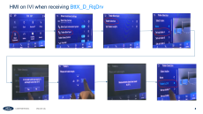
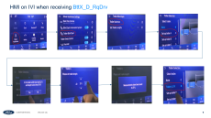
Signal Diagram – incremental for BTT only
For U625C Timberline
APIM
IPC
BttX_D_RqDrv
BttX_D_RqDrv
Btt_L_Actl
BttX_D_Stat
BttX_D_Stat
GWM
HS3
Btt_L_Actl
BttX_D_RqDrv
MS1
TrlrLampCnnct_B_Actl
TrlrLampCnnct_B_Actl
BttX_D_Stat
TRM
SODL+SODR

Slide 5

Signal Diagram – incremental for BTT Key signals only
For U625C ICA2
APIM
IPC
Btt_L_Actl2
BttX_D_RqDrv
BttX_D_Stat
GWM
HS3
Btt_L_Actl2
BttX_D_RqDrv
MS1
TrlrLampCnnct_B_Actl
TrlrLampCnnct_B_Actl
BttX_D_Stat
TRM
ADAS/(SODL+SODR)

Slide 6
ECU impaction
ECU | Current status | Impaction/Effort
SOD | Already implemented in U625 | Spec study & enable the feature Lead to launch Verification
IPC | Already implemented | 1. enable the feature & verification
APIM | No implantation or spec | Study spec and design HMI Supplier implementation Verification
Netcom & GWM | No relevant BTT signals in DBC | Netcom to add relevant BTT signals GWM to route the signals
VE | Lack of trailer related test experience | Performance test
Risks and effort in IVI implementation
Verification effort unclear on both performance test & feature sign-off
No BTT core

Slide 7
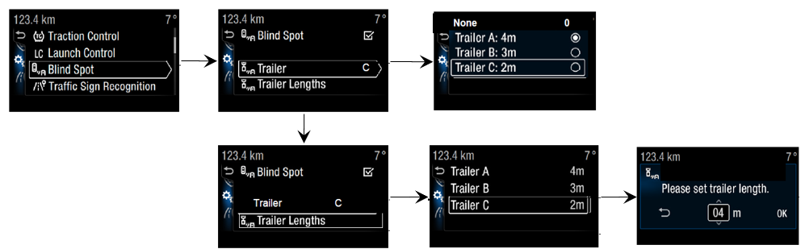
HMI on IPC when receiving BttX_D_RqDrv

Slide 8
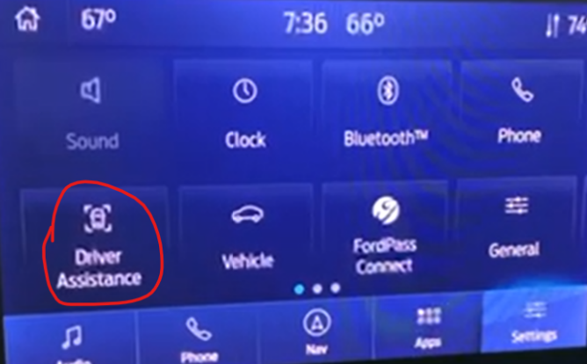
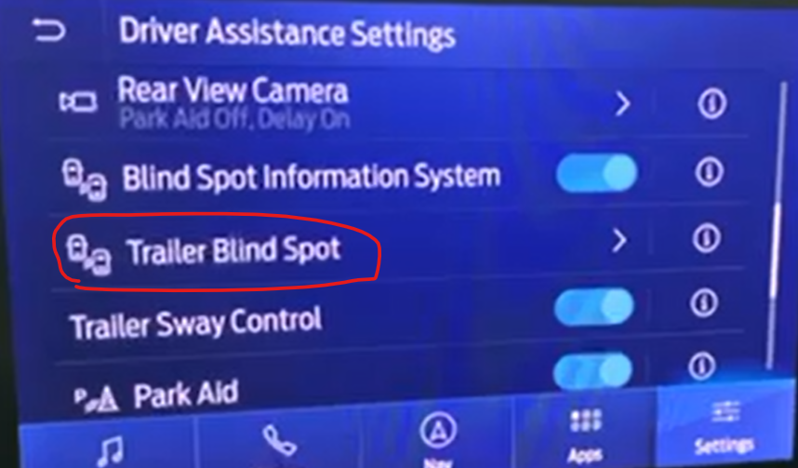
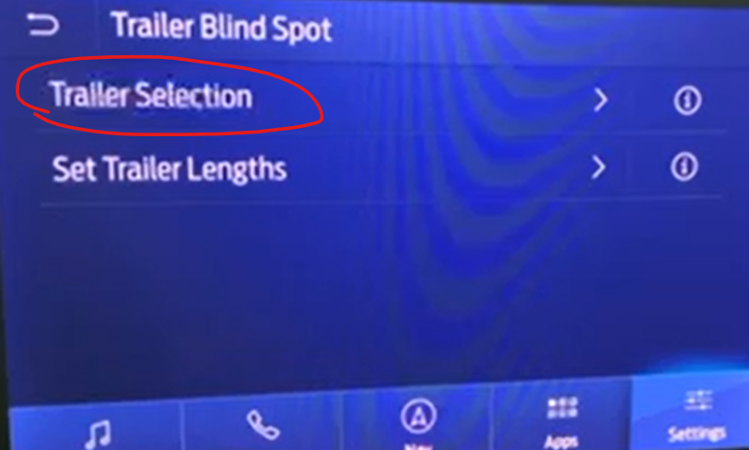
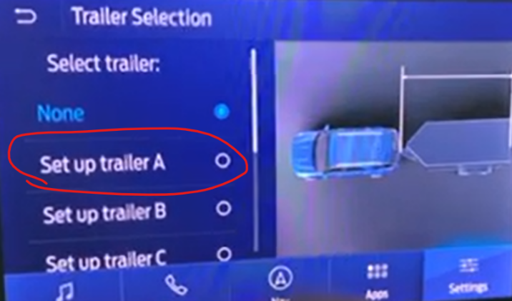
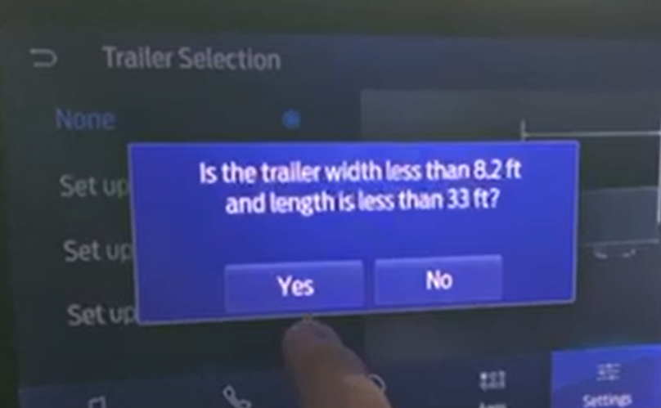
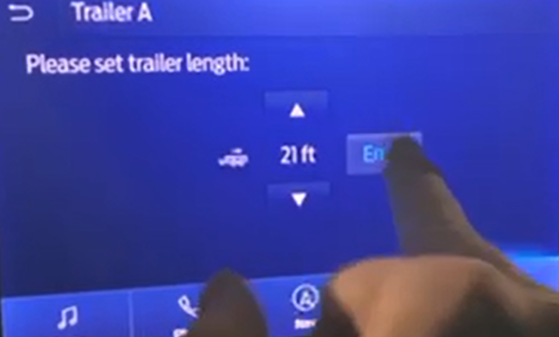
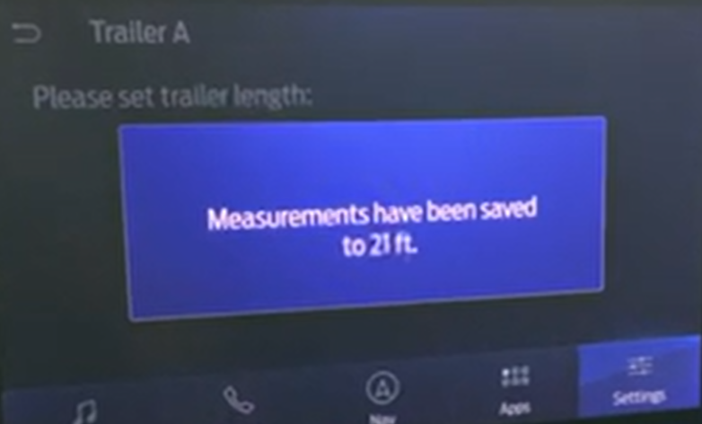
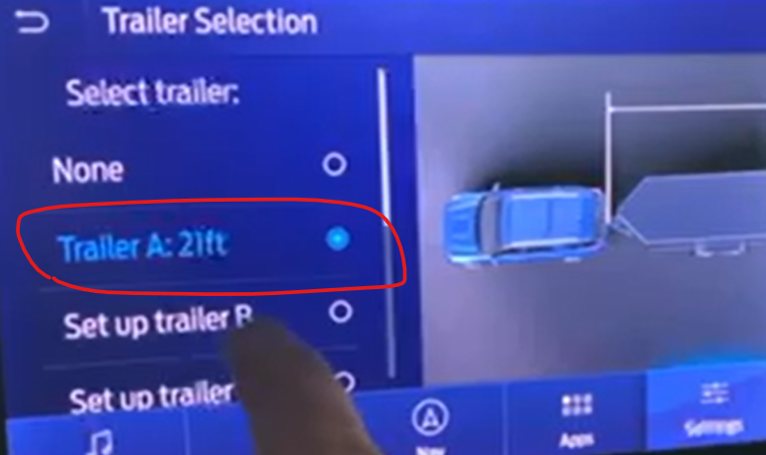
HMI on IVI when receiving BttX_D_RqDrv

